Slide 1

CrisisAid Route Planner
Sabrina Abdukadirova & Vrutti Patel

Slide 2

Project Overview
Web-based application for route planning
Finds the best route between locations
Considers Distance, Safety, Road conditions
Uses a graph-based model with weighted edges
Focus: distance, risk, and travel cost optimization

Slide 3

Significance of the Project
Aid delivery in conflict zones is dangerous and urgent
Bad routes = delays and risk
This system:
Reduces risk
Saves time
Uses resources efficiently
Shows how algorithms solve real-world problems

Slide 4
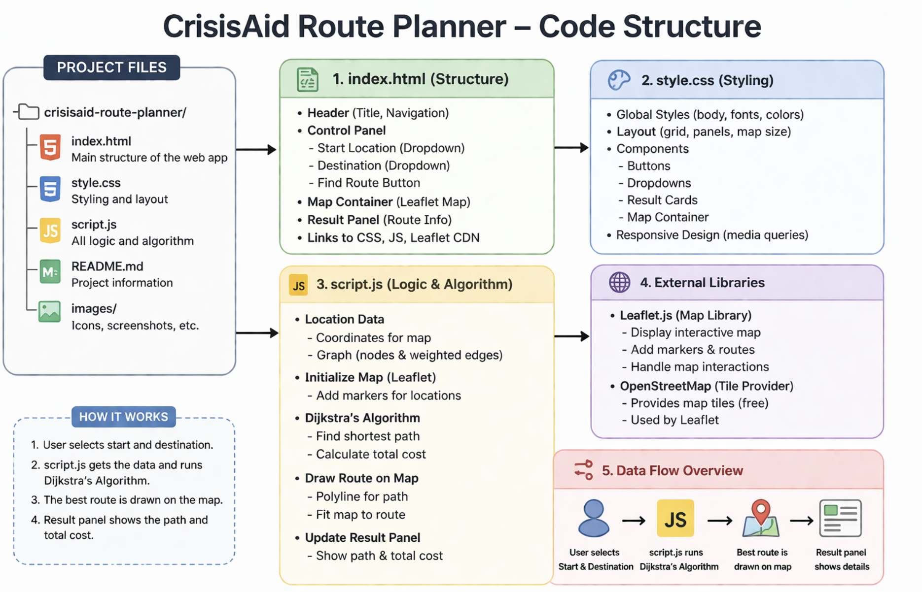

Slide 5
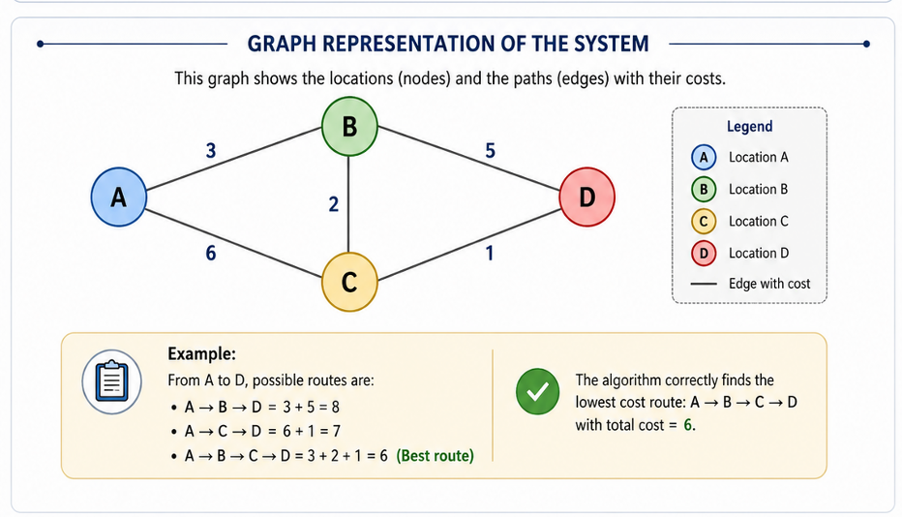
Algorithm Used
Uses Dijkstra’s Algorithm
Locations = nodes
Roads = weighted edges
Finds path with lowest total cost
Cost includes:
Distance
Risk
Difficulty

Slide 6
Conclusion
The project demonstrates route optimization using Dijkstra’s Algorithm.
It finds the most efficient path between locations.
It shows how algorithms can support better decision-making in emergencies.

